Slide 1
Learning Unit 4 Intents, Data passing, and Debugging

Slide 2
Objectives
Understand and use Intents
Passing data between activities
Use the Android Studio debugger
Accessibility
Understand the importance of app performance
Introducing fragments

Slide 3
Intents and Passing Data
Learning Unit 4

Slide 4
Intent class
An Intent class is a structure that specifies:
Messaging objects
An operation to be performed
An event that has occurred
Broadcast by one component
Received by 0 or more components

Slide 5
Intent Types
There are two types of intents:
Explicit intents:
specify the component to start by name (the fully-qualified class name). You'll typically use an explicit intent to start a component in your own app, because you know the class name of the activity or service you want to start. For example, start a new activity in response to a user action or start a service to download a file in the background.
Implicit intents:
do not name a specific component, but instead declare a general action to perform, which allows a component from another app to handle it. For example, if you want to show the user a location on a map, you can use an implicit intent to request that another capable app show a specified location on a map.

Slide 6
How both intents work?
Explicit intent:
starts a named activity or service directly suing the Intent object.
Implicit intent:
In this case, the Android system finds the appropriate component to start by comparing the contents of the intent to the intent filters declared in the manifest file of other apps on the device.
If the intent matches an intent filter, the system starts that component and delivers the Intent object. If multiple intent filters are compatible, the system displays a dialog so the user can pick which app to use.

Slide 7
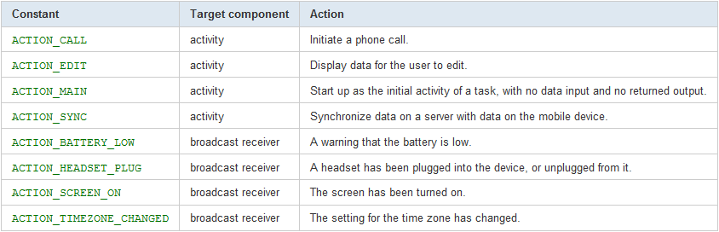
What in the intents?
An Intent is a messaging object
that carries information that the Android system uses to determine which component to start.
These are:
1- Component name (optional)
2- Action
A string that specifies the generic action to perform:

Slide 8
Inside the Intent: Actions
Setting the Intent action for viewing:
ACTION_VIEW
Use this action in an intent with startActivity() when you have some information that an activity can show to the user, such as a photo to view in a gallery app, or an address to view in a map app.
intent = Intent(Intent.ACTION_VIEW)
intent.setData(Uri.parse("https://www.google.com/"))
startActivity(intent)
intent= Intent(Intent.ACTION_VIEW, Uri.parse("https://www.google.com/"))
startActivity(intent)

Slide 9
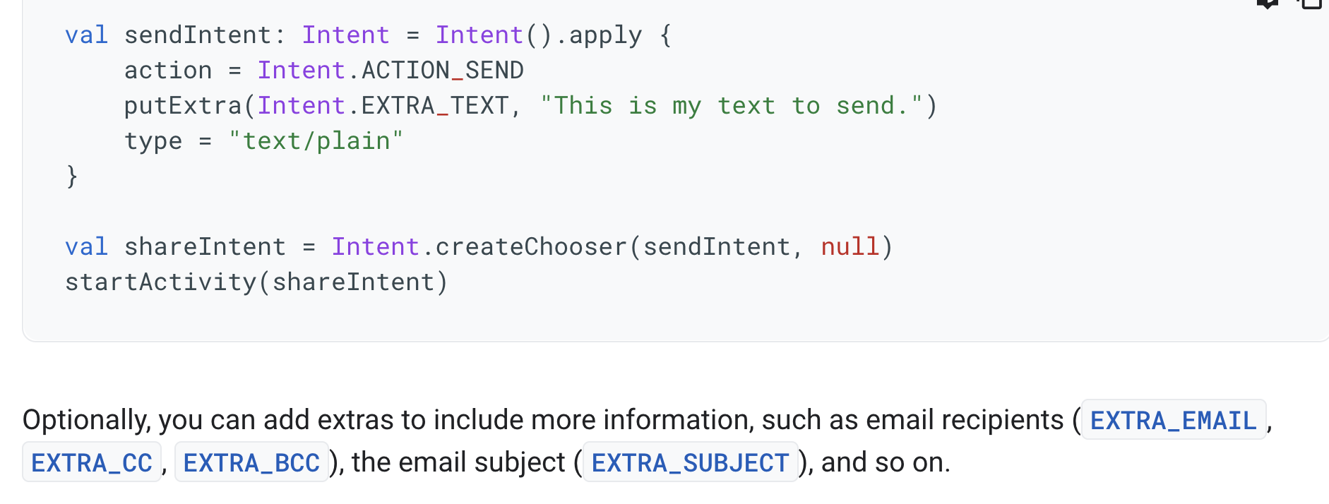
More Actions (cont.)
Setting the Intent action for viewing:
ACTION_SEND
Also known as the "share" intent, you should use this in an intent with startActivity() when you have some data that the user can share through another app, such as an email app or social sharing app.

Slide 10
Inside the Intent: Data (cont.)
Example of Data
Data for a map:
geo:0,0?q=Farmingdale+State+College
+New York+USA
And
newInt = Intent(Intent.ACTION_VIEW);
newInt.setData(Uri.parse("tel:+5160000000"));

Slide 11
Inside the Intent: Extra
Extras
Setting the Extra attribute
Several forms depending on data types,
e.g.,
▪ putExtra(String name, String value);
▪ putExtra(String name, float[] value);
Key-value pairs that carry additional information required to accomplish the requested action. Just as some actions use particular kinds of data URIs, some actions also use particular extras.

Slide 12
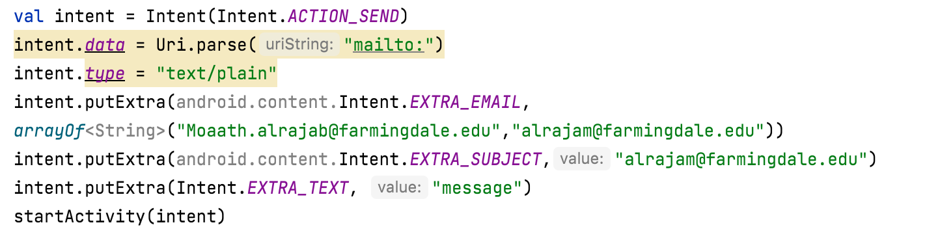
Inside the Intent: Extra (cont.)
For example, when creating an intent to send an email with ACTION_SEND, you can specify the "to" recipient with the EXTRA_EMAIL key (above), and specify the "subject" with the EXTRA_SUBJECT key.

Slide 13
Intent Resolution
When the system receives an implicit intent to start an activity, it searches for the best activity for the intent by comparing the intent to intent filters based on three aspects:
The intent action
The intent data (both URI and data type)
The intent category

Slide 14
Debugging
Learning Unit 4

Slide 15
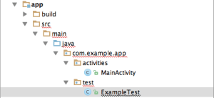
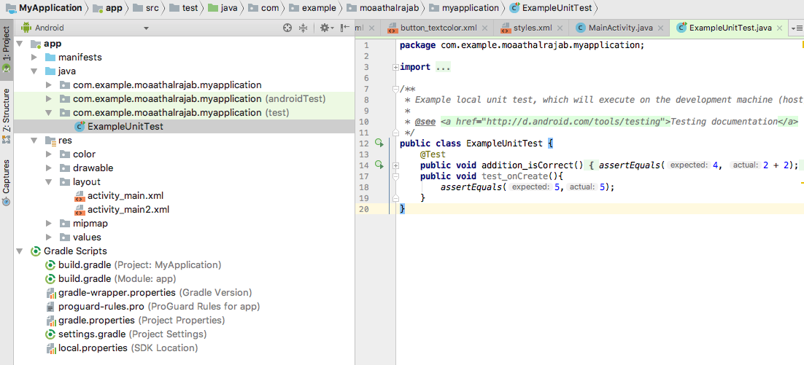
Unit Testing With Android Studio
Native to Android Studio?
Android Studio supports Android Unit Tests natively and you can enable them by setting a few options in your project configuration.
You have the option also to create your own tests by adding a new class.

Slide 16
Writing tests to run on the Android device
Instrumentation tests Instrumented unit tests are unit tests that run on Android devices and emulators instead of running on the Java virtual machine.
These tests have access to the real device and its resources and are useful to unit test functionality which cannot be easily mocked by mocking frameworks.
An example is a test which validates a Parcelable implementation.
An instrumentation-based test class allows you to send key events (or touch events) to the application under test.

Slide 17
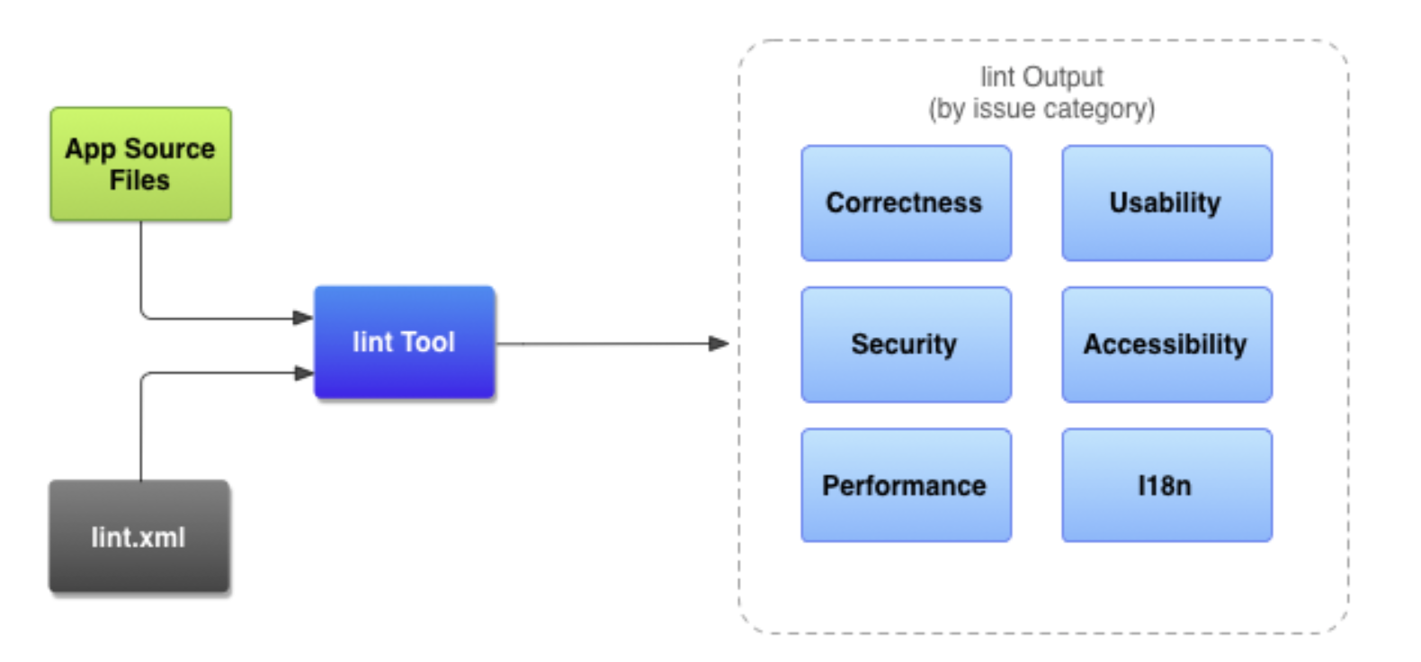
Improve your code with lint checks
You can manually run configured lint and other IDE inspections by selecting Code > Inspect code. The results of the inspection appear in the Inspection Results window.
Set the inspection scope and profile
Select the files you want to analyze (inspection scope) and the inspections you want to run (inspection profile), as follows:
In the Android view, open your project and select the project, a folder, or a file that you want to analyze.
From the menu bar, select Analyze > Inspect Code.
In the Specify Inspection Scope dialog, review the settings.
Under Inspection profile, keep the default profile (Project Default).
Click OK to run the inspection.
Reference: https://developer.android.com/studio/write/lint

Slide 18
Introduction to Android Fragments
Learning Unit 4

Slide 19
Fragments
Android introduced fragments in Android 3.0 (API level 11), primarily to support more dynamic and flexible UI designs on large screens, such as tablets.
Because a tablet's screen is much larger than that of a handset, there's more room to combine and interchange UI components.
Fragments allow such designs without the need for you to manage complex changes to the view hierarchy.

Slide 20
Fragments: what are they?

Slide 21
Fragments: what are they?
A fragment is used to render and manage a single UI view..
Fragments are parts of the application's UI or behavior that are integrated into activities -- a fragment needs an activity to run.
Consider each fragment as a lightweight mini-activity.
Fragments are flexible and reusable components defined by the programmer.
Fragments present a consistent UI across different apps and devices; fragments are flexible in adapting the user experience across these different environments (phone, tablet); therefore, allowing to group UI views.
Each fragment has its own lifecycle and associated UI (for example, a fragment for the user to enter profile information, another one to render maps).
How many fragments do you need? Rule of thumb is one per different type of data displayed (e.g., preferences, profile, maps, list of exercises) or user input.

Slide 22
Treat a fragment as a mini-activity with its
own independent UI and Lifecycle (to manage its internal state).
Fragments should be considered as part of the controller layer in the MVC architecture

Slide 23
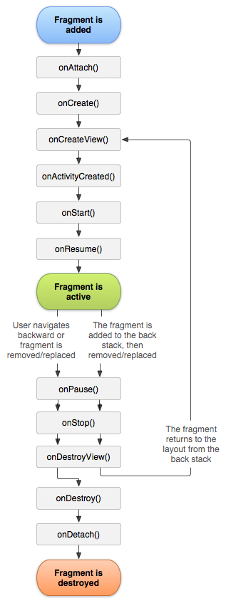
Fragment Lifecycle
onAttach() is called when the Fragment is attached to its parent activity
onCreate() is called to initially create the fragment
onCreateView() is called to created its user interface -- it inflates the fragment UI
onActivityCreated() is called once the parent activity and the fragment UI are created.
onStart() is called the start of the visible lifetime, any UI changes can be applied before the fragment goes visible
onResume() is called at the start of the active lifetime such as resuming any paused UI updates needed by the fragment that were suspended when it became inactive.

Slide 24
Fragment Lifecycle
onPause() called at the end of the active lifetime; persist all edits or state changes, suspend UI updates, threads, or CPU intensive processes that don't need to be updated when the Activity isn't the active foreground activity
onSaveInstanceState() called to save UI state changes at the end of the active lifecycle
void onStop() called at the end of the visible lifetime
onDestroyView() called when the fragment's view is detached
onDestroy() called at the end of the full lifetime
onDetach() called when the Fragment has been detached from its parent activity

Slide 25
What have we learnt this unit?
The use of Intents
Passing data between activities
Use the Android Studio debugger
Accessibility
Understand the importance of app performance
Introducing fragments

